Slide 1

Say goodbye to semi-colons
Moving the June Agricultural Census from SAS to R
Lucy Nevard
RESAS

Slide 2
Farmer survey (paper and online)
Cattle data
Historic census data
Agricultural Census dataset
~60,000 farms (rows) with ~200 variables
Crops, livestock, labour, geographies
Single Application Form (payments)
Geographies
Admin data from Rural Payments and Services
Crofting Commission Register of Crofts
Notes:
- data sources in different formats

Slide 3

Legacy SAS project
~70 programs with ~200 lines of code each
Multiple contributors over nearly 20 years
Many commented out sections
Programs labelled “TO REVIEW”

Slide 4
Why move the Agricultural Census code?
Within Transformation Programme
Survey changes
Allowed methodological changes
Allowed collaboration
Opportunity to review the process

Slide 5
Our approach
Iterative
Write working R code to produce final dataset
May not work for everyone

Slide 6
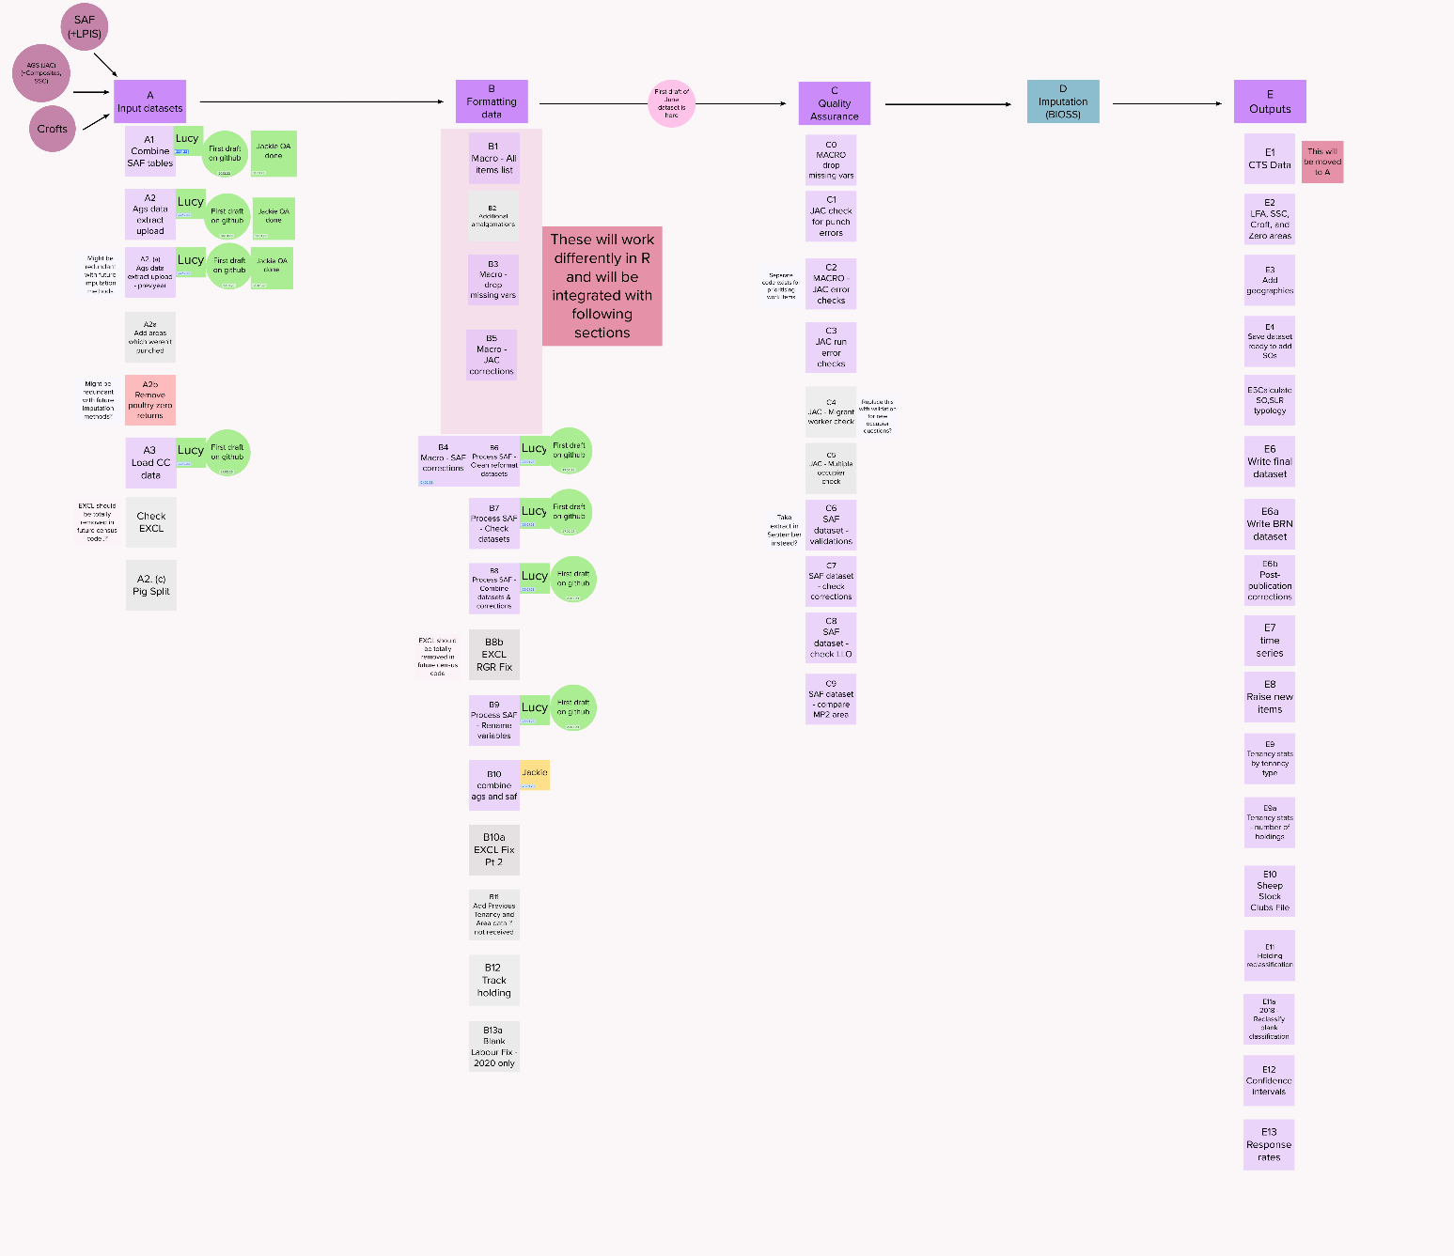
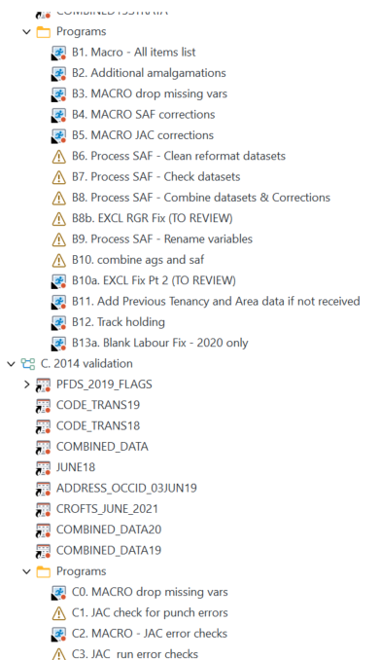

Slide 7
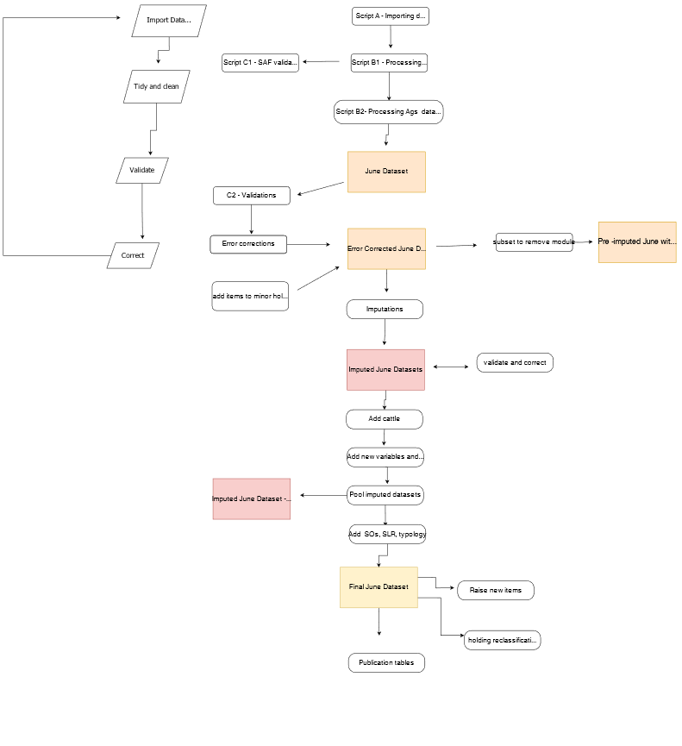
Notes:
- RAP team gave good feedback on simplifying this

Slide 8
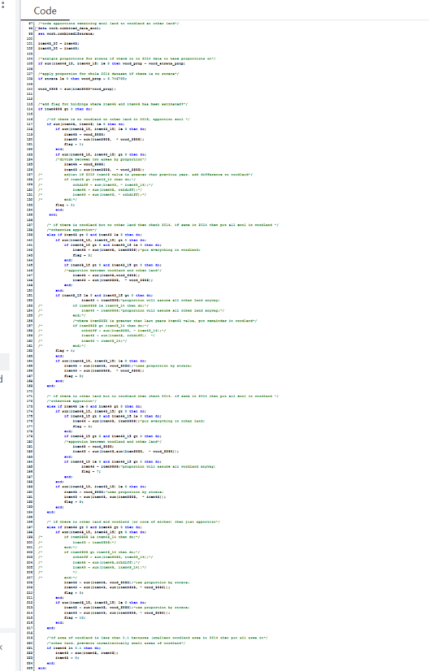
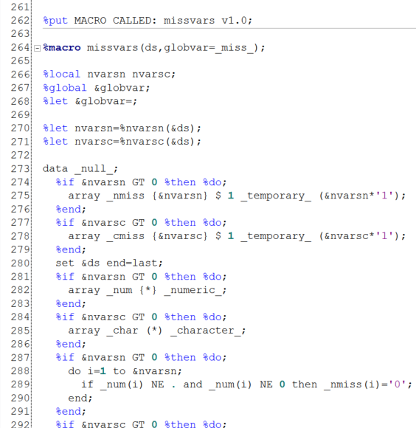
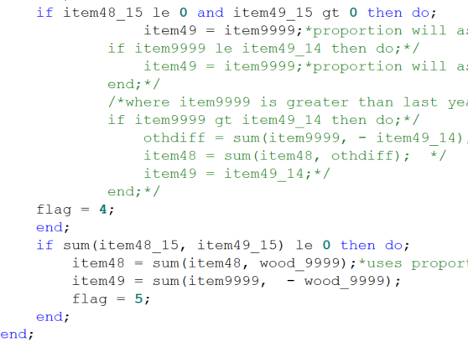
Step 1 : disentangling SAS code
Notes:
- datasets loaded from various libraries
- macros
- nested if statement

Slide 9
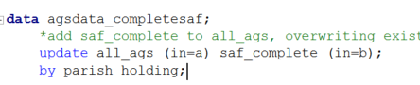
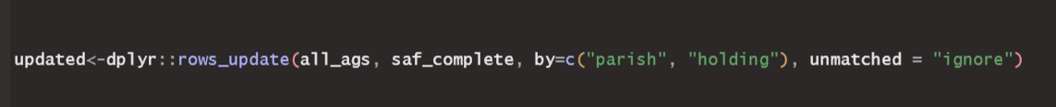
Step 2 : finding the correct function in R
Notes:
- We had experience in R between us but important to keep up with developments!
- explain problem
- first time round
- discovering rows_update

Slide 10
Step 3 : matching the outputs
Test on historic data
Can be tricky when SAS and R treat missing values differently
SAS sum – disregards missing values
sum() in R will give NA unless na.rm=TRUE

Slide 11
Code differences
SAS | R
Not case-sensitive | Case-sensitive
No commas between variable names | Commas between variable names
Syntax, e.g. rename old_name=new_name | dplyr::rename new_name=old_name
Statements end in semi-colons | No semi-colons
Missing value = “.” Disregards when calculating | Missing value = “NA” Use na.rm=TRUE
Functions have distinct names | Functions can have same name in multiple packages
Must sort datasets before merging | No need to sort datasets before merging
Rounds to nearest number | Rounds to nearest even number (in base R)
Throws warnings for non-existent variable but still runs | Throws error (stops running) for non-existent variable

Slide 12
Useful functions
clean_names janitor
round_half_up janitor
roundSAS tidytlg
read_sas(“filename.sas7bdat”) haven
Write into SAS: ADM library within SAS
ADM mailbox: adm.support@gov.scot
R package for ADM: RtoSQLserver DataScienceScotland/RtoSQLServer (github.com)

Slide 13
Tips
Detailed planning– know where crucial code is hidden
Agree coding rules at the beginning
Use existing data – QA as you go
Keep names similar as possible to SAS project – easier for QA
Save interim outputs every time
Use version control e.g. git
External QA early on e.g. Support for Reproducible Analytical Pipelines (sharepoint.com)
Good to get code written even if it’s not perfect
Notes:
- planning – things become clearer later on
-github e.g. 2021->2023 data, new branch. Code publicly available

Slide 14
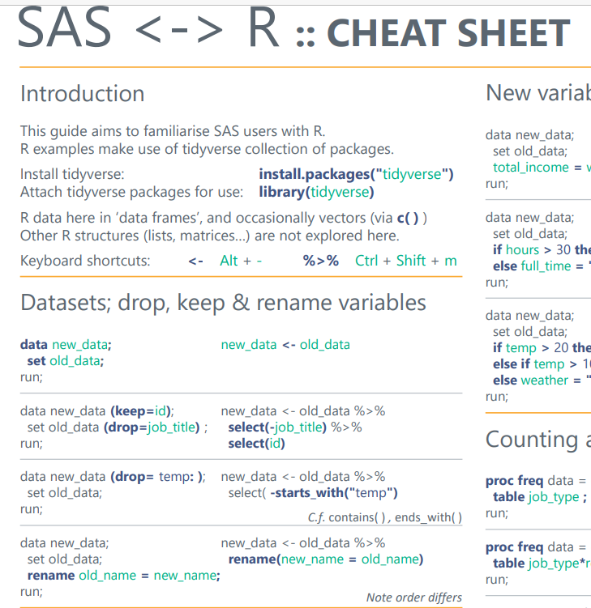

Resources
brendanjodowd/SAS-R: SAS to R cheatsheet (github.com)
asnr/sas-to-r: Translate SAS to R (github.com)
R for SAS programmers: It's different, but friendly (lexjansen.com)
SAS vs R Programming: Which to Choose and How to Switch | R-bloggers
conflicted: a new approach to resolving ambiguity (tidyverse.org)

